Slide 1
Charm++ : a very brief Introduction
Laxmikant (Sanjay) Kale
http://charm.cs.illinois.edu
Parallel Programming Laboratory
Department of Computer Science
University of Illinois at Urbana Champaign
Notes:
<number>

Slide 2
Exascale Challenges
Main challenge: variability
Static/dynamic
Heterogeneity: processor types, process variation, ..
Power/Temperature/Energy
Component failure
Exacerbated by strong scaling needs from apps
Why?
To deal with these, we must seek
Not full automation
Not full burden on app-developers
But: a good division of labor between the system and app developers
<number>

Slide 3
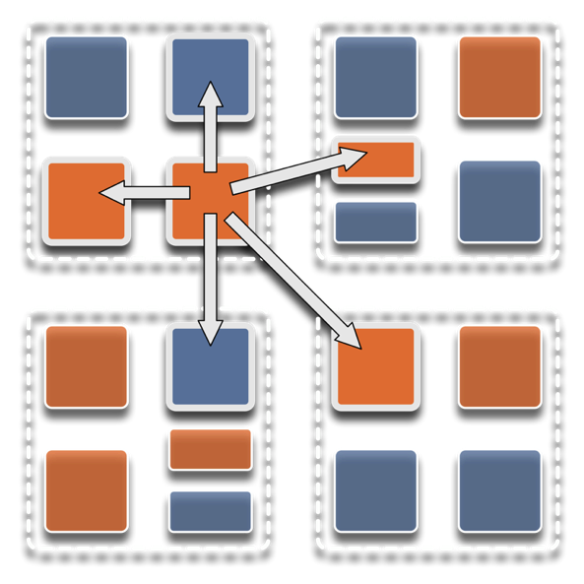
Overdecomposition
Decompose the work units & data units into many more pieces than execution units
Cores/Nodes/..
Not so hard: we do decomposition anyway
<number>

Slide 4
Migratability
Allow these work and data units to be migratable at runtime
i.e. the programmer or runtime, can move them
Consequences for the app-developer
Communication must now be addressed to logical units with global names, not to physical processors
But this is a good thing
Consequences for RTS
Must keep track of where each unit is
Naming and location management
<number>

Slide 5
Asynchrony: Message-Driven Execution
Now:
You have multiple units on each processor
They address each other via logical names
Need for scheduling:
What sequence should the work units execute in?
One answer: let the programmer sequence them
Seen in current codes, e.g. some AMR frameworks
Message-driven execution:
Let the work-unit that happens to have data (“message”) available for it execute next
Let the RTS select among ready work units
Programmer should not specify what executes next, but can influence it via priorities
<number>

Slide 6
Message-driven Execution
A[..].foo(…)
Processor 0
Processor 1
Scheduler
Scheduler
Message Queue
Message Queue

Slide 7
Processor 0
Processor 1
Scheduler
Scheduler
Message Queue
Message Queue
Processor 2
Processor 3
Scheduler
Scheduler
Message Queue
Message Queue
Notes:
<number>

Slide 8
Processor 0
Processor 1
Scheduler
Scheduler
Message Queue
Message Queue
Processor 2
Processor 3
Scheduler
Scheduler
Message Queue
Message Queue
Notes:
<number>

Slide 9
Processor 0
Processor 1
Scheduler
Scheduler
Message Queue
Message Queue
Processor 2
Processor 3
Scheduler
Scheduler
Message Queue
Message Queue
Notes:
<number>

Slide 10
Empowering the RTS
Adaptive
Runtime System
Introspection
Adaptivity
Asynchrony
Overdecomposition
Migratability
The Adaptive RTS can:
Dynamically balance loads
Optimize communication:
Spread over time, async collectives
Automatic latency tolerance
Prefetch data with almost perfect predictability
<number>
Notes:
<number>

Slide 11
Benefits in Charm++
Over-decomposition
Scalable Tools
Automatic overlap of Communication and Computation
message-driven execution
Perfect prefetch
compositionality
Emulation for Performance Prediction
Migratability
Fault Tolerance
Introspective and adaptive runtime system
Dynamic load balancing (topology-aware, scalable)
Temperature/Power/Energy Optimizations
<number>

